Slide 1
Energy Management System
System Electronics High Risk Investigation
Donald MacIntyre – April 14, 2015

Slide 2
Presentation Overview
Energy Management System Overview
System Electronics Overview
Risk Specification
Risk Investigation – Solutions Considered – Pugh Tables
Risk Mitigation Design Details
Parts List
Testing Strategy
Uncertainties
Questions

Slide 3
Energy Management System Overview
The Energy Management system is being developed to provide a modular power control and monitoring solution for homes and small business allowing for improved energy management.
The Energy Management System allows users to:
Monitor total power consumption
Control and schedule power consumption remotely
The Energy Management will consist of two principal hardware components:
Main Unit – Contains master controller, data storage and hosts web application
Remote Units – Contains all necessary hardware electronics to perform:
Load switching
Power measurements
Power line communication

Slide 4
Main Unit
Functional Block Diagram

Slide 5
Remote Outlet Modules
Functional Block Diagram

Slide 6
Remote Outlet Modules
To simplify the system electronics risk investigation, the remote outlet modules were focused on and the investigation was broken into the following parts:
Power Supply – AC to DC Power Conversion
Surge Protection
Switching Control
Power Sensing
Current Sensing
Voltage Sensing
Controller

Slide 7
Power Supply
Module | AC to DC Power Supply
Inputs | AC Voltage: 120 VRMS 60 Hz
Outputs | DC Voltage: Low voltage DC Supply and references voltages
Power | 2 watts or less expected (will depend on final circuit design needs)
Functionality | Convert AC line voltages to necessary voltages to power all other modules. Each module powered by this block will have current and voltage power requirements which this block shall meet.
 | Concepts
Selection Criteria | Capacitive Coupled Circuit | Linear Supply | Switch Mode Supply
Power Delivered | 0 | + | +
Isolation | - | + | 0
Size | + | - | +
Cost | + | - | -
Positive | 2 | 2 | 2
Neutral | 1 | 0 | 1
Negative | 1 | 2 | 1
Net Score | 1 | 0 | 1
Rank | 1 | 2 | 1
Continue | Yes | No | Yes
Block Requirements and Concept Selection

Slide 8
Surge Protection
Module | Surge Protection
Inputs | Voltage: 120 VRMS 60 Hz
Outputs | Voltage: Surge protected output voltage
Surge Energy | Investigate recommendations for typical household branch circuit
Functionality | This module shall provide protection from voltage spikes and/or surges which is typically seen in the home due to lightning strikes. In the event of a power surge/spike all devices shall be protected such that they are functional after a power event.
 | Concepts
Selection Criteria | GDT | TVS | MOV | TSPD
Cost | - | 0 | + | 0
Energy Dissipated | + | - | 0 | +
Response Time | - | + | 0 | 0
Clamping Voltage | 0 | 0 | 0 | +
Length of Life | - | - | + | 0
Positive | 1 | 1 | 2 | 2
Neutral | 1 | 2 | 3 | 3
Negative | 3 | 2 | 0 | 0
Net Score | -2 | -1 | 2 | 2
Rank | 4 | 3 | 1 | 1
Continue | No | No | Yes | No
Block Requirements and Concept Selection

Slide 9
Load Switching
Module | Switching Control
Inputs | Voltage: 120 VRMS 60 Hz Digital: Enable Signal with the desired status of the switch control unit encoded.
Outputs | Current: Ability to conduct 20 ARMS with minimal power loss
Functionality | Capable of switching a load on or off based on an input signal. A system stretch goal also includes being able to modify the power delivered to a load thus producing a dimming functionality which would provide a method for saving power for purely resistive loads.
 | Concepts
Selection Criteria | Triac | Relay | Transistor
Cost | 0 | 0 | 0
Switching Speed | + | 0 | +
Isolation | 0 | + | -
Interfacing | 0 | 0 | -
Power Dissipated | + | - | 0
Phase Control | + | 0 | 0
Positive | 3 | 1 | 1
Neutral | 3 | 4 | 3
Negative | 0 | 1 | 2
Net Score | 3 | 0 | -1
Rank | 1 | 2 | 3
Continue | Yes | No | No
Block Requirements and Concept Selection

Slide 10
Power Sensing Requirements
Module | Power Sensing
Inputs | Voltage: 120 VRMS 60 Hz Current: 0.5 ARMS min, 20 ARMS max
Outputs | Digital: Digital value representing the amount of current sensed. Digital: Digital value representing the amount of voltage sensed.
Functionality | Measure current through and voltage across a load, at a sample rate high enough to calculate RMS values of non-sinusoidal waveforms.
Block Requirements

Slide 11
Power – Current Sensing
Current Sense
 | Concepts
 | Sampling Resistor | Hall Effect Sensor | Integrated Circuit
Effect on circuit | - | + | +
Accuracy | - | 0 | +
Cost | + | 0 | 0
Positive | 1 | 1 | 2
Neutral | 0 | 2 | 1
Negative | 2 | 0 | 0
Net Score | -1 | 1 | 2
Rank | 3 | 2 | 1
Continue | No | No | Yes
Concept Selection – Pugh Table

Slide 12
Power – Voltage Sensing
 | Concepts
Selection Criteria | Differential Amplifier | Optical Isolator
Accuracy | 0 | 0
Cost | + | -
Interfacing | 0 | 0
Isolation | 0 | +
Linearity | + | 0
Positive | 2 | 1
Neutral | 3 | 3
Negative | 0 | 1
Net Score | 2 | 0
Rank | 1 | 2
Continue | Yes | No
Concept Selection – Pugh Table

Slide 13
Controller
Module | Controller
Inputs | Voltage: DC Input Voltage Digital: Control Signals From Main Unit Analog: Current Measurement data Analog: Voltage Measurement data
Outputs | Digital: Control information to main unit Digital: Load Switching Control Enable
Functionality | Control current and voltage sampling hardware, control switching circuitry and transmit/receive data to/from main unit.
 | Concepts
Selection Criteria | TI MSP430 | STMicro | PIC
Cost | + | 0 | +
Size | + | + | +
Development Tools | + | - | 0
Development Time | 0 | 0 | 0
Interface | 0 | 0 | 0
Positive | 3 | 1 | 2
Neutral | 2 | 3 | 3
Negative | 0 | 1 | 0
Net Score | 3 | 0 | 2
Rank | 1 | 3 | 2
Continue | Yes | Yes | Yes

Slide 14
Power Supply – Design Risk Mitigation
Based on analysis completed, the power supply design was broken up into an iterative process with two solutions.

Slide 15
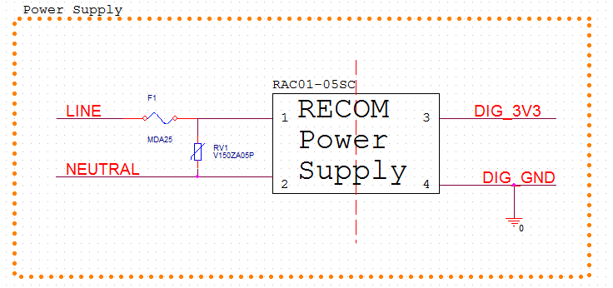
Power Supply – Generation 1
Recom Switch Mode Supply
Will provide electrical isolation during testing and debugging process
Provide a proven and working solution thus allowing for debugging and troubleshooting efforts to be spent working on more serious unknowns
Shortcomings of Generation 1 Power Supply
Recom power supplies are expensive ($12.34 dollars a unit) and would not be feasible for a production environment

Slide 16
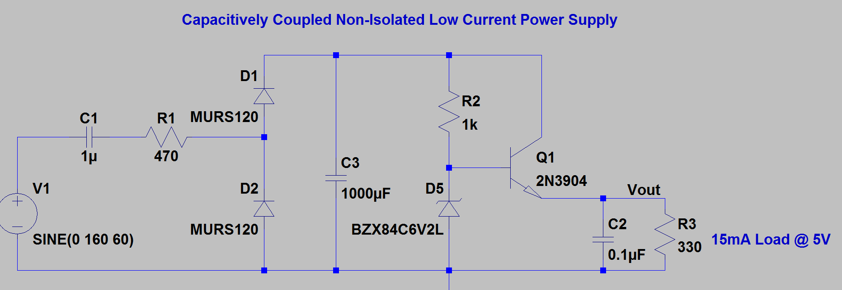
Power Supply – Generation 2
Capacitively Coupled Power Supply
Will provide a cheap solution allowing the project to meet cost goals.
Will provide a smaller implementation thus taking up less board space
Shortcomings of Generation 2 Power Supply
Dependent on low power demands
All electronics will be running at line potential (no isolation), which is common in competing products such as the Kill-a-Watt meter

Slide 17
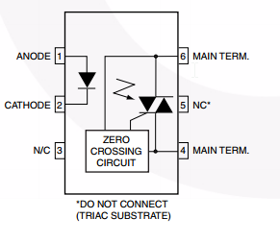
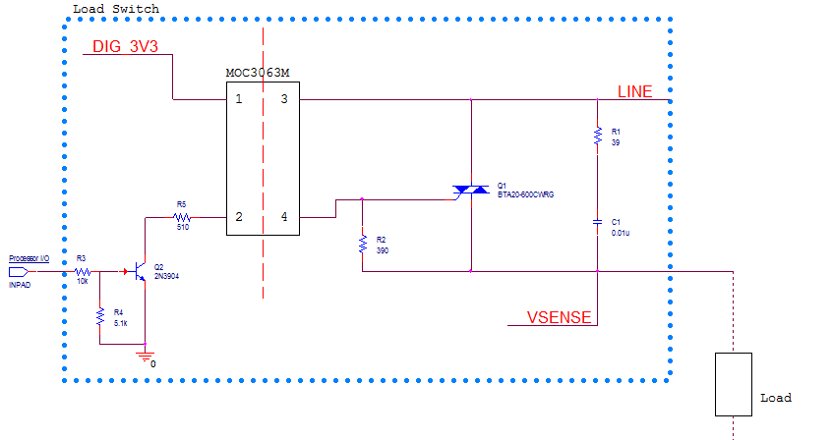
Load Switch – Design Risk Mitigation
Triac – bidirectional device, commonly used as switches in AC circuits
MOC3063M – optically coupled triac driver, allows isolated source (processor) to drive the load
Contains zero crossing circuitry thus mitigating need to develop software to fire the triac
Mitigates Design:
Inexpensive proven solution
Provides isolation between processor and AC line electronics
Meets all design requirements
Provides ability to meet stretch goal of phase control
MOC3063M - Schematic

Slide 18
Surge Protection – Design Risk Mitigation
Surge Protection easily mitigated as it is addressed by all electronics currently manufactured
Surge protection circuitry:
No effect on circuit during normal operation
MOV will dissipate excess energy in event of a surge
Slow blow fuse will further protect circuitry by blowing if MOV fails as a short circuit

Slide 19
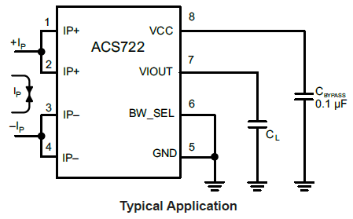
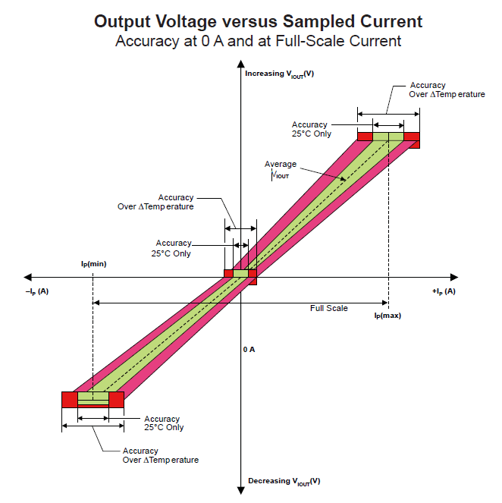
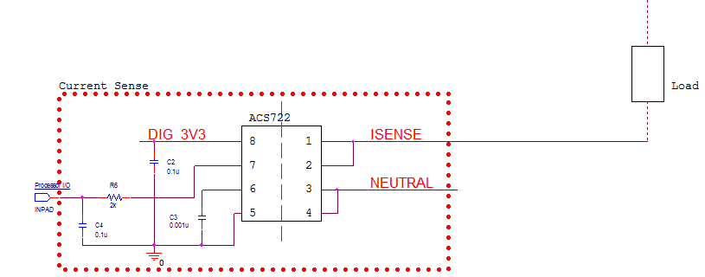
Current Sensing – Design Risk Mitigation
Hall Effect Current Sensor – Provides a DC voltage that can be sampled by controller which corresponds to measured current.
Mitigates Design:
Inexpensive proven solution
Isolation between digital and AC line electronics
Due to Hall Effect, no effect on the load

Slide 20
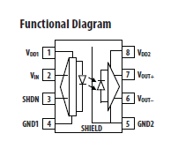
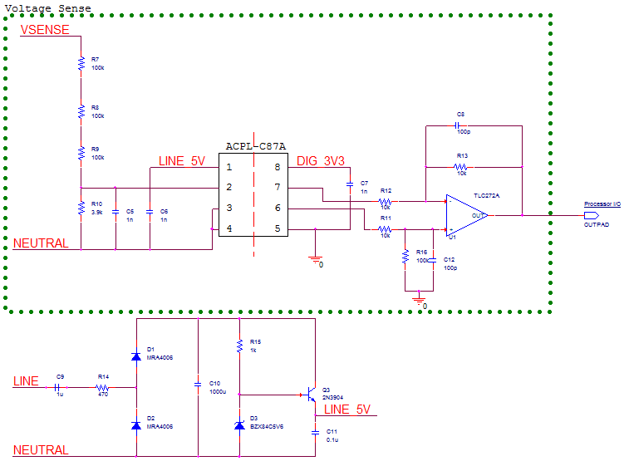
Voltage Sensing – Design Risk Mitigation
Optically Isolated Amplifier designed for voltage sensing
2V input range, high input impedance minimizing loading effects
Provides differential output voltage proportional to input voltage
Uses sigma delta modulation to transmit across isolation barrier
ACPL-C87A, requires reference voltage with respect to neutral
Simply DC power supply needed to provide 5V reference
Mitigates Design:
Inexpensive proven solution
Isolation
Little effect on load

Slide 21
Controller – Design Risk Mitigation
Mitigates Design:
Extensive application notes and source code available, can be used as a basis for this project
Excellent development tools
Has analog to digital hardware built in thus eliminating need for custom ADC hardware
Tasks of the Controller

Slide 22
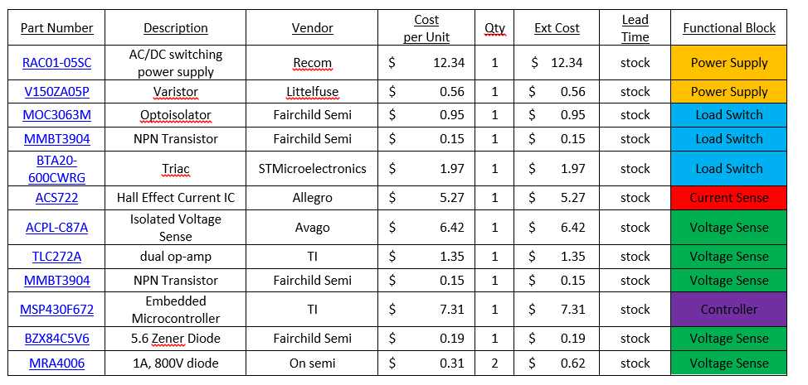
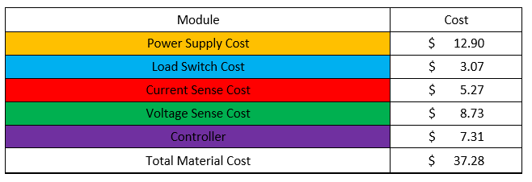
Parts List

Slide 23
Testing Strategy
Four Phase Testing Plan
Phase 1 – Breadboard Testing of Functional Blocks
Phase 2 – Initial Firmware Development with Evaluation Board
Phase 3 – Interface Processor Evaluation Board to Functional Blocks
Phase 4 – Prototype Evaluation
Phase 1 – Breadboard Testing | April 2015
Phase 2 – Controller Eval / Firmware Testing | May 2015
Phase 3 – Controller Eval Integration with Functions | September - October 2015
Phase 4 – Prototype Testing | October – November 2015

Slide 24
Uncertainties
Power Supply
Effect of Power Line Communication (PLC) on power supply currently is an unknown.
Power Sensing
Rate at which we want to sample
Controller
Number of I/O needed for PLC interface
Communication protocol between PLC interface
Data transmission speeds
Required power calculations
Sampling Rate

Slide 25
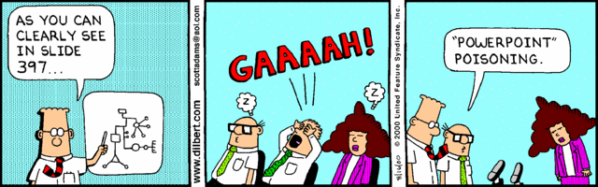
Questions?

